Slide 1
Audio systems
Dvd player, Hi-Fi Amplifier, PA System,Home theater
https://epdf.pub/dvd-players-and-drives.html
J S RATALE.

Slide 2
Dvd player
Definition – It is electronic unite , use to playback prerecorded Audio and video signal information present in DVD.
Audio information playback using stereo sound system
Video information playback using Display unite. Like. Tv

Slide 3
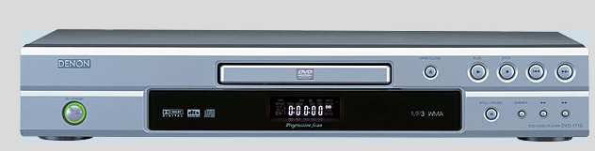
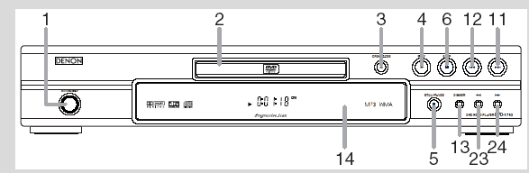
Front panel of DVD player
1- power on switch
2- disc try with remote sensor
3- open close button
4- Disc navigation button , Play pause , stop , FF, Rf, next ,
5- Display unit
bass treble control

Slide 4
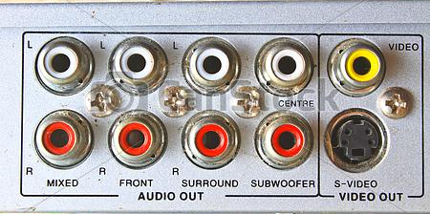
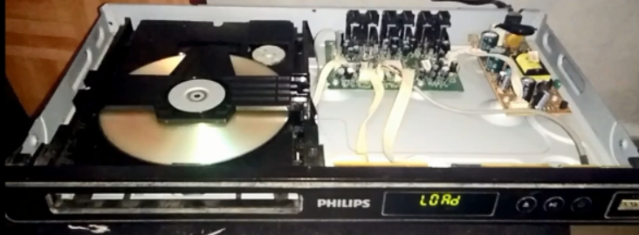
Back panel and internal part of DVD player

Slide 5
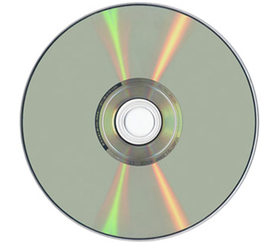
What is a DVD?
A Digital Versatile Disc/Digital Video Disc [DVD]
is an optical disc storage medium like a compact disc [CD], but with greater data storage(gigabytes) and high quality audio and video formats.
Dvd may record data single or double side .
DVD is encoded in the form of small pits and bumps in the track of the disc.(1's and 0's)

Slide 6
Specifications of DVD
DVD has a total capacity of 4.7 GB , 8.54, 9.4, 13.24 or 17 GB .
Space is 4.75 inches , 1.2mm thick
Diameter size 12cm and 8 cm
It can run a high-quality video for a maximum of 133 minutes.
DVD has a video compression ratio of 40:1 with an MPEG-2 compression
DVD is only 740 nanometers thick
DVD discs which are single-sided as well as double-sided.

Slide 7
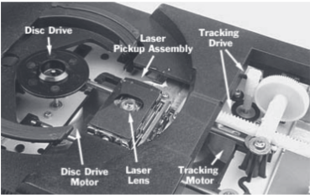
parts of a DVD player are
1. Disc drive mechanism
2. Optical system
3 decoder system
4 audio and video signal processing unit

Slide 8
operation of the DVD player
It includes play, pause ,forward , stop, eject and standby , is carried out by the user either directly by pressing the appropriate button on the front panel or
indirectly by using a remote control handset.

Slide 9
parts of a DVD player are 1 Disc drive mechanism
disc drive mechanism consists of a motor that will drive the disc in a circular motion.
a loading tray that is used to accept the DVD from the user by manually or using remote control facility
entire disc drive is basically a spindle that holds the disc and a motor that is used to circle the disc

Slide 10
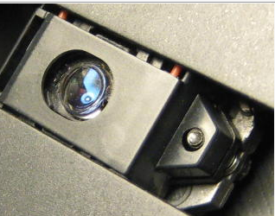
Optical system
The optical system mainly consists of the laser beam, lenses, prism, photo-detectors and also mirrors.
The optical system also requires a motor to drive it.
The laser system and photo-detector is placed together on a single platform
Reading data from dvd and converting into digital code.

Slide 11
DVD detection
When the optical pickup head moves across the dvd track, it generates a tracking error signal. If the tracking error voltage is low (0.4 V or less), then the inserted disk is a DVD.
2v for CD tracking error signal

Slide 12
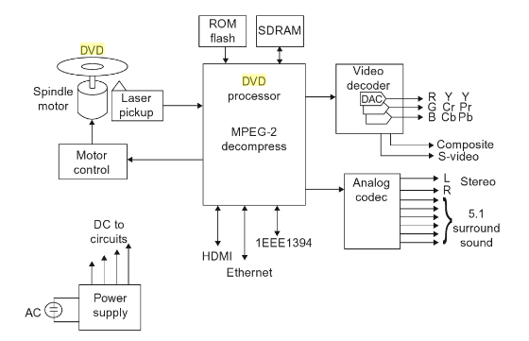
Dvd player
1. Disc drive mechanism
2. Optical system
3 decoder system
4 audio and video signal processing unit

Slide 13
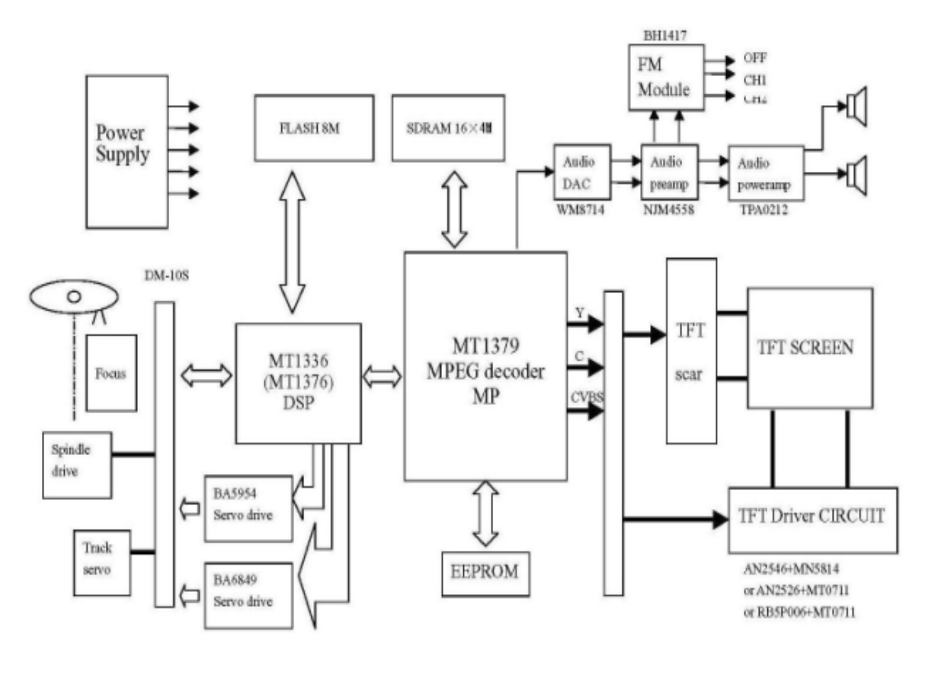

Slide 14
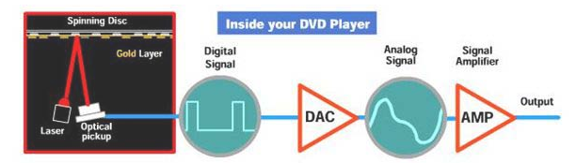
Working
Aluminum Gallium arsenic material diode is used to generate light beam .
reflected laser beams are then collected by a light sensor (eg. photo-detector) which converts the light to electrical signals then into a binary code .

Slide 15
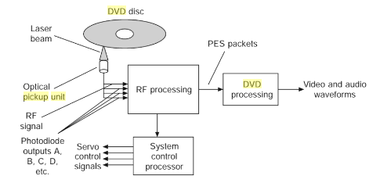
Optical pick up unit
Its function extracts data from dvd Using laser beam and then converted ino rf signal from photo diode arrary.
optical pickup unit is mounted on an arm placed under the disc along which the pickup head can move to follow a track or read different tracks.

Slide 16
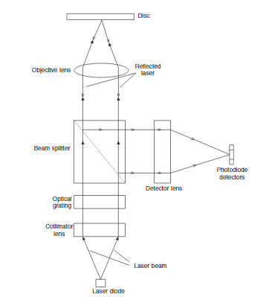
Optical pickup unit assembly (basic components)
Diode – generate light beam for data read purpose
Beam pass through Lens & beam splitter toward disc
Reflected beam from dvd pass to photo detector
Photo diode convert convert light to electrical

Slide 17
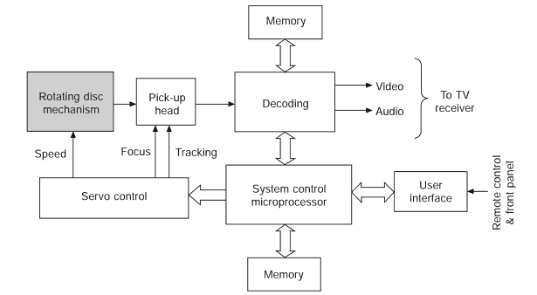
Dvd playback process
Peck up head read data on disc
Decoded data from photodiode gives A V O/P
Beam focus control by microprocessor
Memory required for processing & Routing.

Slide 18

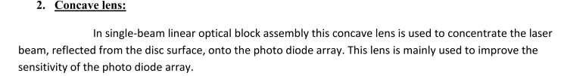
Lens
- Collimation lens - Concave lens - Objective lens - Cylindrical lens

Slide 19
Objective lens – is used to focus laser beam on to the disc surface and to receive the reflected beam.
This lens is move up and down to achieve focus of the laser beam on the disc face.

Slide 20
Drive motors
- Tray, loading motor - Slide, sled, feed motor - Spindle, disc, turntable motor.
Tray (carriage) motor- When the open/close switch is pressed, the carriage motor moves the Dvd tray in and out for loading and unloading the Dvd. Thus the function of this motor is to „push out‟ or inject as well as to push in the Dvd tray
Feed motor: This motor moves the optical pick up unit from the centre to the outer edge of the disc on sliding rods. Some players have pick up motors that travels in a radial or semicircle fashion. This motor keeps an objective lens constantly in line with the centre of the optical axis or track

Slide 21
Spindle motor - A drive motor spins the disc. This drive motor is precisely controlled to rotate between 200 and 500 rpm
Feed motor: This motor moves the optical pick up unit from the centre to the outer edge of the disc on sliding rods. Some players have pick up motors that travels in a radial or semicircle fashion. This motor keeps an objective lens constantly in line with the centre of the optical axis or track .The feed motor may have a fast forward and fast reverse mode operation

Slide 22
Advantages of DVD
Very large storage capacity 4.7-9 Gb
Sound and picture quality is excellent .(mpeg – video / pcm, dts –audio)
DVD uses a higher sampling rate and can store more information
DVD drives can read CDs

Slide 23
disadvantages of DVD
DVDs do not work in CD drives
They can be easily damaged by breaking or scratching
Current players can't play in reverse at normal speed.
It doesn't fully support HDTV.

